Slide 1

Operation Performance
Monthly Report
MTD 24.09.19

Slide 2
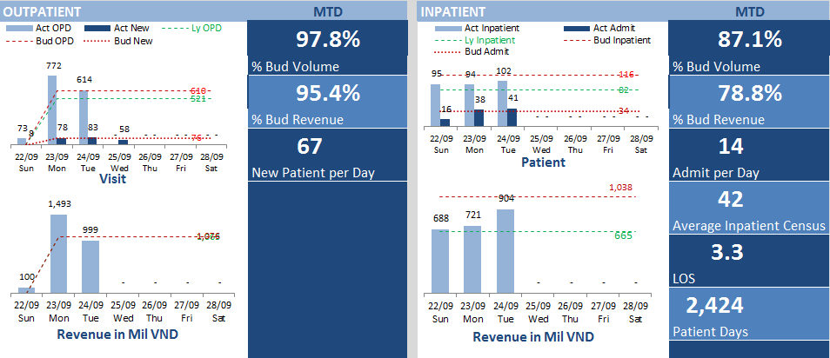
OVERVIEW

Slide 3
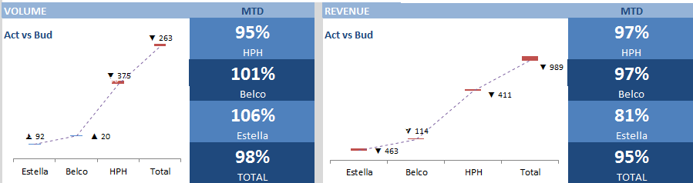
OPD By Location

Slide 4
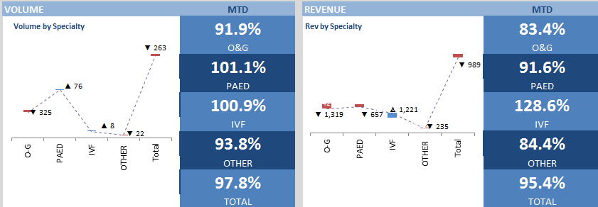
OPD By Specialty

Slide 5
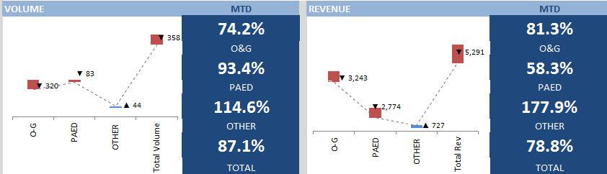
IPD

